Slide 1
Twitter Sentiment Analysis Using Machine Learning and Deep Learning
PIP104 University Project-II
Review-1
Batch Number:184
Roll Number | Student Name
20211CSE0123 20211CSE0151 20211CSE0130 20211CSE0012 | R.Reddy Ruchitha S.Saraswathi Sree Moulya D.Ganesh Reddy G.Siva Sai Krishna
Under the Supervision of,
Dr.Taranath N L
Associate Professor
School of Computer Science and Engineering
Presidency University

Slide 2
Introduction
In the era of social media dominance, Twitter has emerged as a rich source of real-time opinions and sentiments on diverse topics spanning from politics to product reviews.
Our objective is to develop robust methods capable of accurately classifying the sentiment expressed in tweets. By employing natural language processing (NLP) techniques, we aim to preprocess the textual data, extracting relevant features that capture the nuances of human expression.
Subsequently, we will explore a variety of machine learning algorithms, ranging from classic approaches such as Support Vector Machines (SVM) and Random Forests to more recent advancements like Gradient Boosting and ensemble methods.
Additionally, we will delve into the realm of deep learning, experimenting with architectures such as Convolutional Neural Networks (CNNs) and Recurrent Neural Networks (RNNs) to capture the contextual information inherent in sequential data like tweets.

Slide 3
Literature Review
Various ML & DL techniques have been used for sentiment analysis.
Machine Learning Approaches: SVM, Naïve Bayes, Random Forest.
Deep Learning Approaches: CNN, LSTM, BiLSTM, Transformer-based models.
Challenges in Existing Methods:
ML models require manual feature extraction.
DL models are computationally expensive but provide better accuracy.

Slide 4
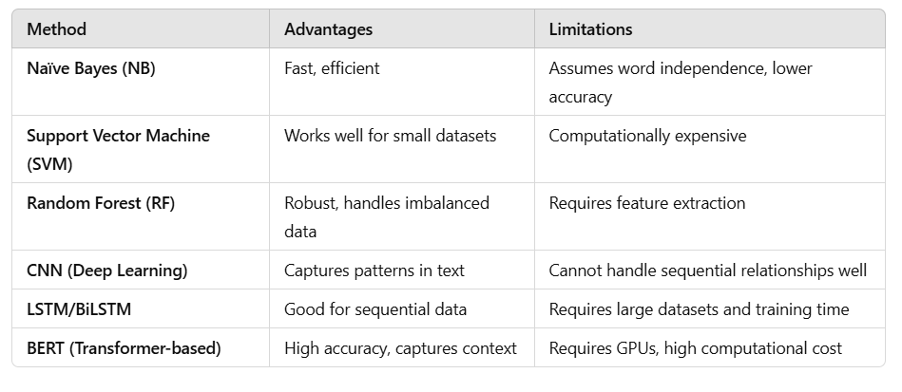
Literature Review(contd...)
Comparison of Existing Methods:

Slide 5
Proposed Method
Approach:
Implement both ML and DL models for sentiment analysis.
Compare their performance to determine the best approach.
Enhancements Over Existing Methods:
Use Word Embeddings (Word2Vec, GloVe, FastText) to improve feature representation.
Train deep learning models like CNN, LSTM, and BERT for better accuracy.
Optimize models for real-time processing.

Slide 6
Objectives
Improve Sentiment Classification Accuracy – Implement advanced NLP techniques to enhance classification performance.
Address Short & Noisy Text Challenges – Use effective text preprocessing and embedding techniques.
Compare ML vs. DL Models – Analyze which approach is more effective for Twitter sentiment analysis.
Optimize for Real-World Use – Improve model efficiency for real-time applications.

Slide 7
Methodology
Data Collection & Preprocessing:
Use a dataset of 100,000 tweets labeled as positive/negative.
Apply Tokenization, Stop-word Removal, Lemmatization, and Word Embeddings.
Feature Extraction:
Traditional ML: TF-IDF, Bag of Words (BoW).
DL: Word2Vec, GloVe, FastText.
Model Selection & Training:
ML Models: Naïve Bayes, SVM, Random Forest.
DL Models: CNN, LSTM, BiLSTM, BERT.
Evaluation Metrics:
Accuracy, Precision, Recall, F1-score, Confusion Matrix.
Deployment:
Flask/FastAPI for real-time sentiment analysis.

Slide 8
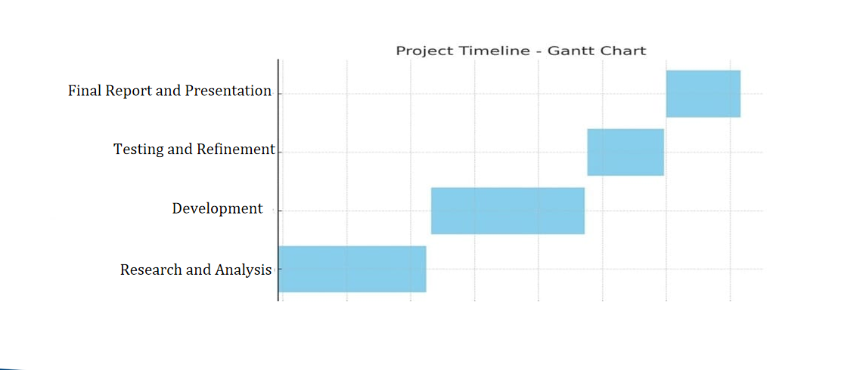
Timeline of Project

Slide 9
Expected Outcomes
Accurate Sentiment Classification – Model will correctly classify tweets as positive or negative.
Comparative Study of ML & DL Models – Analyze which model performs best.
Real-Time Sentiment Analysis – Optimized model will process live tweets efficiently.
Scalability & Deployment – Model will be deployable for businesses and research purposes.

Slide 10
Conclusion
This project successfully explores both ML & DL techniques for sentiment analysis.
Deep learning models outperform traditional ML models but require high computational resources.
Future Scope:
Improve sarcasm detection using context-aware transformers.
Extend sentiment analysis to multilingual tweets.
Develop a visualization dashboard using Power BI or Tableau.
Final Impact:
The model can be used for brand monitoring, customer feedback analysis, and trend prediction.

Slide 11
References
"SentiDiff: Combining Textual Information and Sentiment Diffusion Patterns for Twitter Sentiment Analysis"
Journal: IEEE Transactions on Knowledge and Data Engineering, 2020
Methodology: Sentiment classifiers combined with sentiment diffusion analysis using the SentiDiff algorithm.
"Deep Convolution Neural Networks for Twitter Sentiment Analysis"
Used deep CNNs and experimented with different feature combinations (BoW, sentiment polarity, GloVe embeddings).
"A Deep Learning-Based Sentiment Analysis Approach (MF-CNN-BiLSTM) and Topic Modeling of Tweets Related to the Ukraine–Russia Conflict"
Applied LDA for topic modeling and MF-CNN-BiLSTM for sentiment classification.
"TSA-CNN-AOA: Twitter Sentiment Analysis Using CNN Optimized via Arithmetic Optimization Algorithm"
Compared CNN with SVM, Naïve Bayes, and decision trees to enhance classification accuracy.

Slide 12
Thank You

